Slide 1
Progress Towards a Mobile Manipulator Based on ABB Robotics Technology
^{March 8, 2012}
^{Edward Venator}
^{Profs.} ^{Wyatt Newman, Gregory Lee}

Slide 2
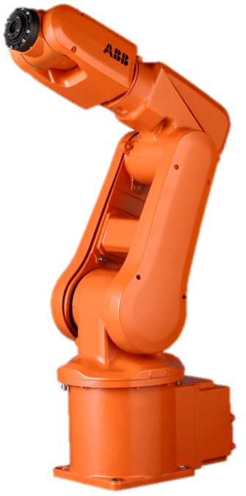
Project Outline
We are developing a mobile manipulator using the ABB IRB-120 and a modified wheelchair base.
This system will be significantly cheaper, more robust and more capable than mobile-manipulator options on the market.
Vehicle capabilities include wheeled locomotion at up to 5 MPH and manipulation and carrying of small objects.
A sensor package including a SICK Lidar and a Microsoft Kinect 3D Camera enable obstacle avoidance and autonomous navigation in the presence of unknown obstacles and people.

Slide 3
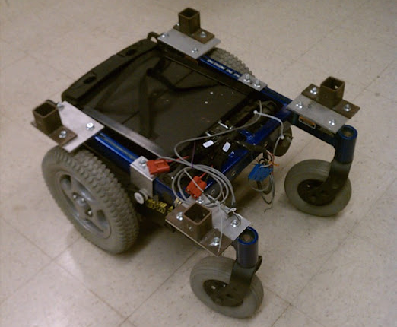
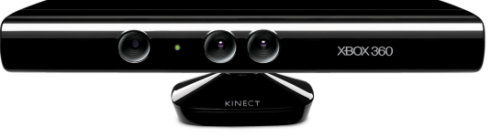
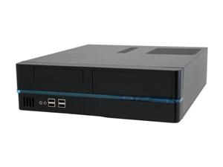
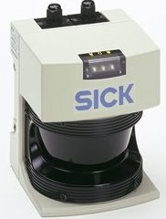
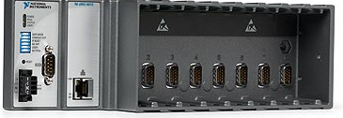
Hardware Overview
An ABB IRB-120 Robotic Arm provides manipulation capabilities
An Invacare electric wheelchair base is a powerful but widely available mobilility platform.
A Microsoft Kinect 3D camera and SICK LIDAR allow the robot to sense obstacles and operate safely around humans
A small form factor PC running Linux and the Robot Operating System (ROS) will perform sensor processing and planning operations.

Slide 4
Applications
With the vehicle described, we intend to explore the use of mobile manipulators for kitting in a factory environment, specifically with Smart Payloads.
How can a robot benefit from packages that are marked with machine-readable information?
What kind of information is useful to a robot? (i.e. mass distribution, grasping affordances, fiducial markings)
How can this information be integrated into an industrial setting? Many packages are already tagged for machine reading and tied to inventory management systems.

Slide 5
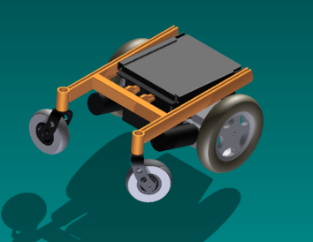
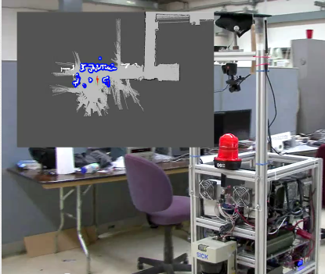
Progress
Much of the preliminary work involving selection of system components has been completed.
Currently, we are investigating the optimal physical configuration of the robot using 3D CAD modeling (above right) to determine the center of gravity and work envelope of possible configurations.
Software to process sensor data and control the mobility platform using ROS has already been developed by others in our research group (below right), and should be applicable to this project with little modification
An upcoming goal is the creation of a gateway between ROS and the IRC5, allowing control of ABB robotics products using ROS.

